Slide 1
UNIVERSITY COLLEGE OF ENGINEERING NAGERCOIL
(Anna University Constituent College)
UCEN-OFFFICE AUTOMATION SYSTEM
USING CLOUD COMPUTING
Guided by,
Dr.J.Banumathi AP/IT
Team Members,
Aakif Muhsin J,
Vibunesh A
Presented By,
Aswin Raja A,

Slide 2
OBJECTIVE
To reduce the time spent on manual work and human error in managing data at college office.
To improve the process of student data handling .
Enhance the students to view their academic profile.

Slide 3
SCOPE
It helps the admin to enhance and keep, manage and control the entire data of the students in our institution.
It helps to access the data easily.

Slide 4
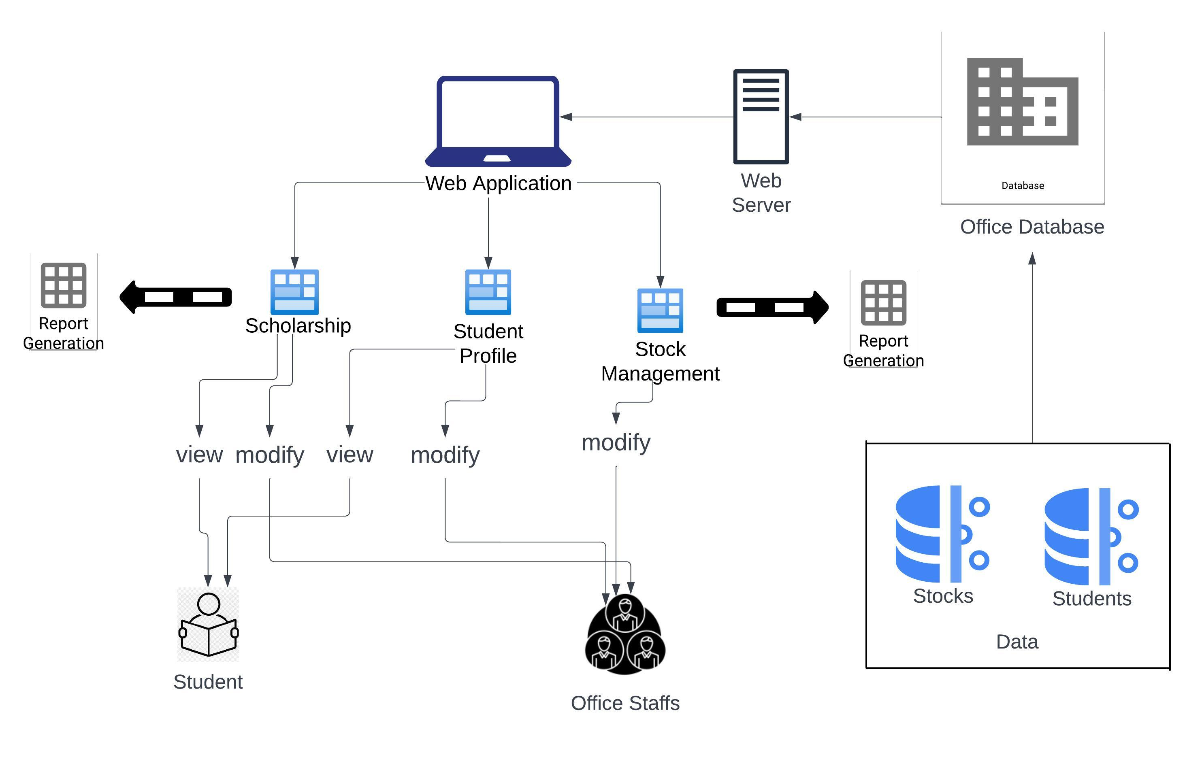
SYSTEM ARCHITECTURE

Slide 5
MODULES
SCHOLARSHIP MANAGEMENT
STOCK MANAGEMENT
STUDENT PROFILE MANAGEMENT

Slide 6
STOCK MANAGEMENT SUB-MODULES
LOGIN
VIEW CONSUMABLE STOCKS & NONCONSUMABLE STOCKS
STOCK ADDITION
STOCK UPDATE, DELETE
STOCK TRANSFER HISTORY

Slide 7
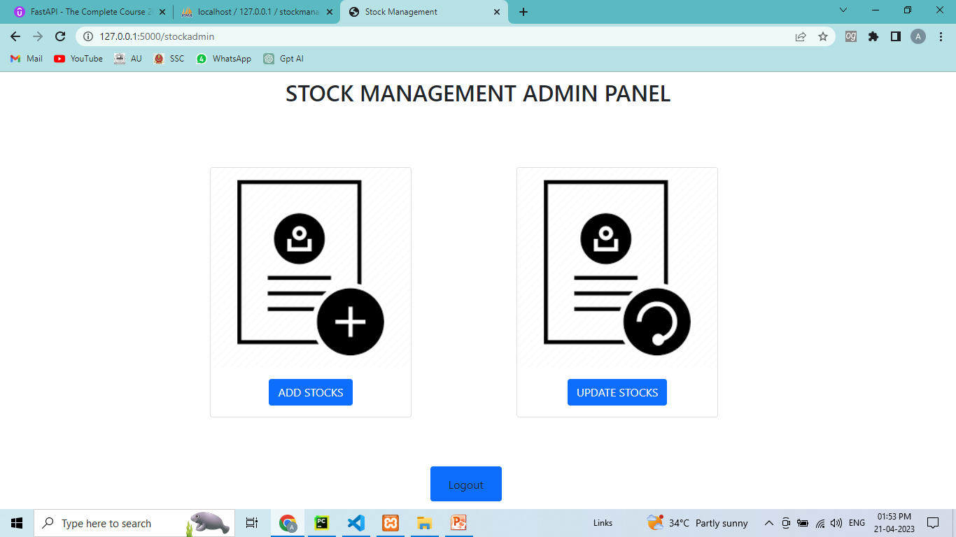
STOCK ADMIN PANEL

Slide 8
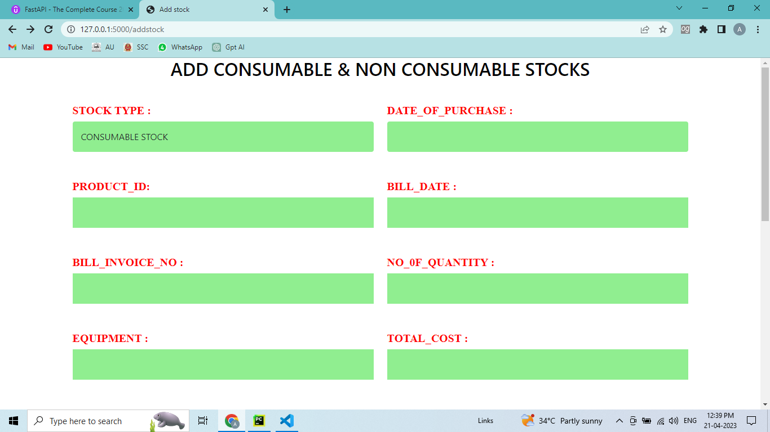
NEW STOCK ADDITION

Slide 9
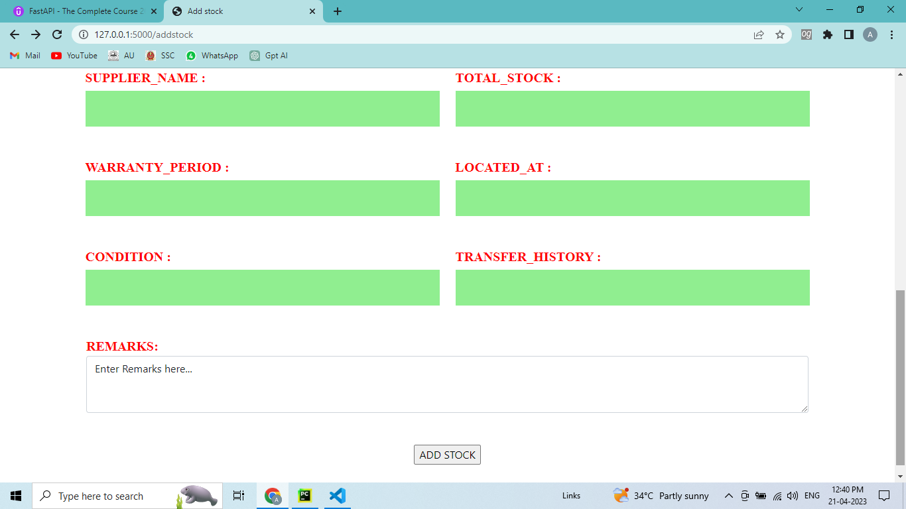
STOCK ADDITION

Slide 10
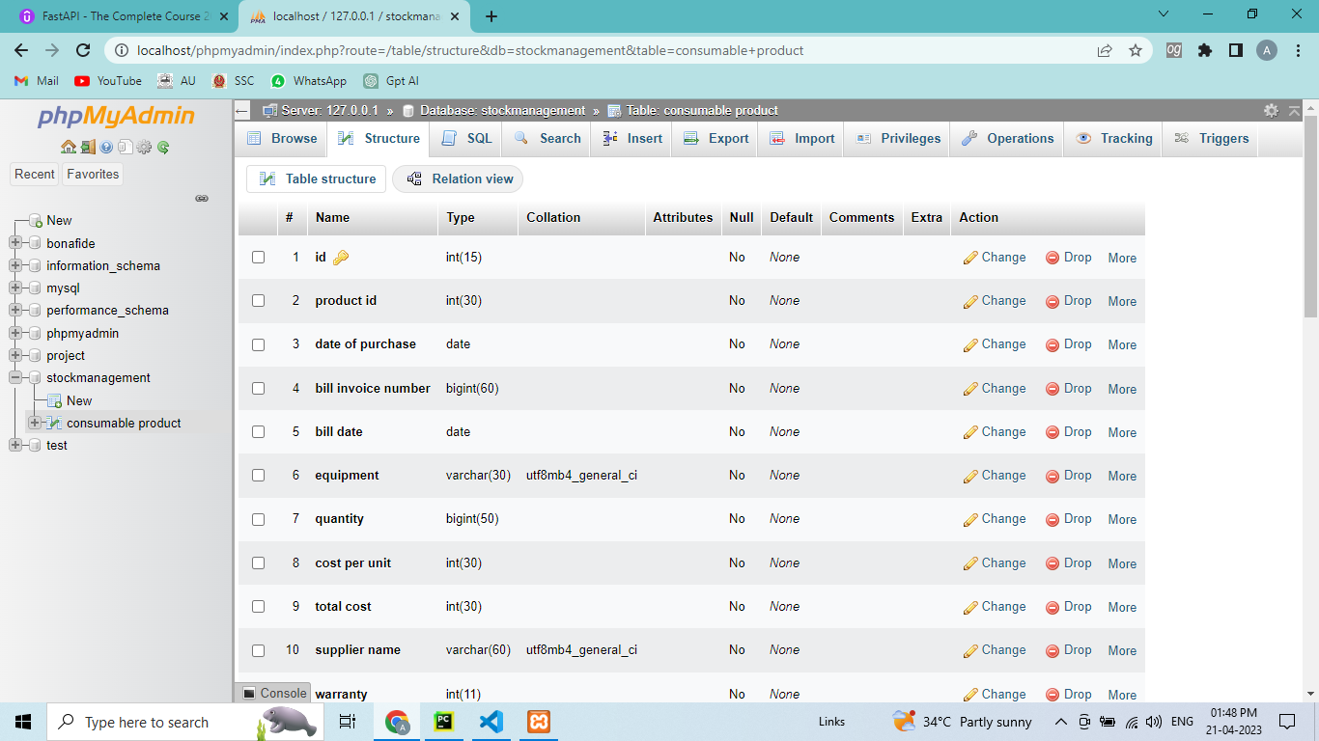
STOCK DATABASE

Slide 11
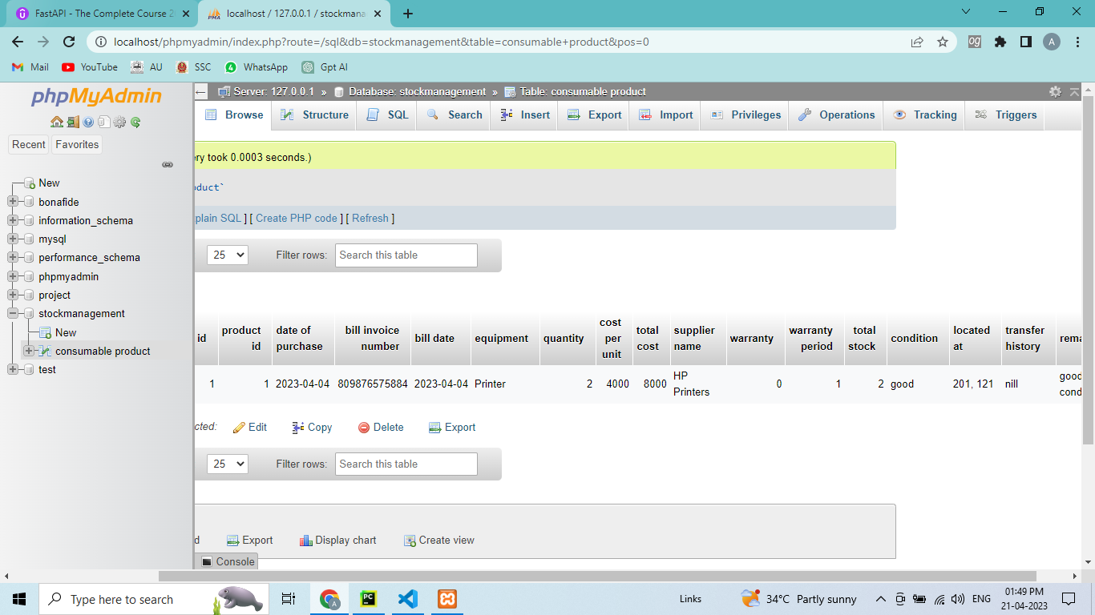
STOCK DATABASE

Slide 12
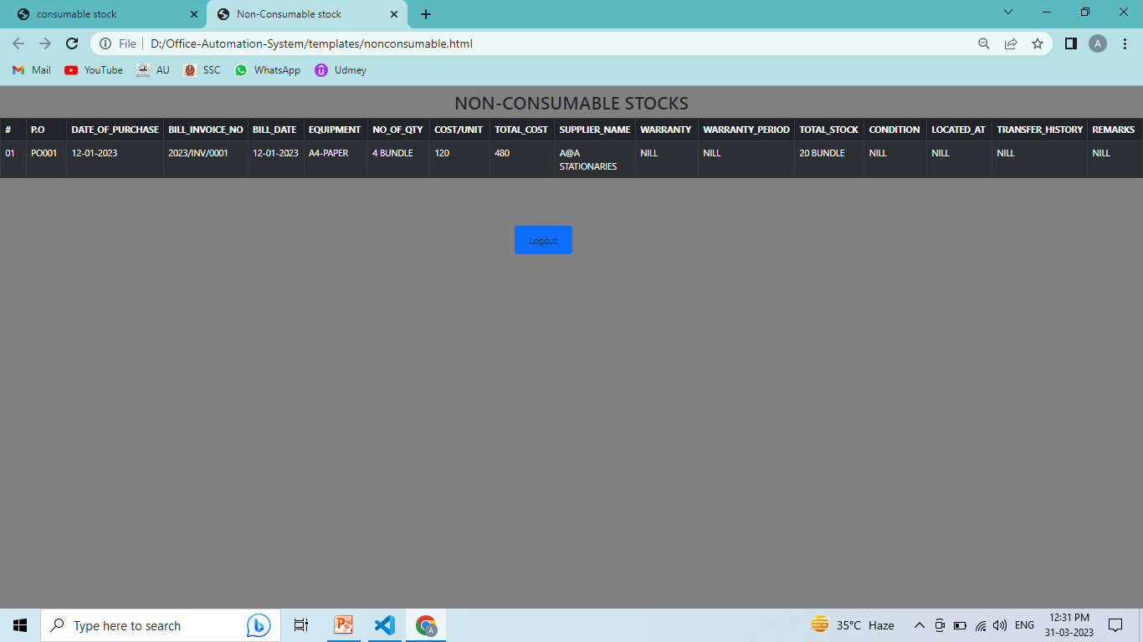
STOCKS - VIEW

Slide 13


